Slide 1
Digestive system/Nutrition
11th grade

Slide 2
October 23, 2013
Complete pre-test on digestive system.
Remember this does not hurt your grade it is to assess what you know.

Slide 3
Vocabulary
Digestion/Metabolism
Absorption
Elimination
Villi
Colon
Liver
Kidney
Bolus
Mastication
Esophagus
Peristalsis
Bile
Pancreas
Gall bladder
Kidney’s
Nephron
Small Intestine
Stomach
Bladder
Hepatitis
Celiac disease
GERD
Ulcer

Slide 4
LQ’s
What structures make up the Digestive system?
The functions of the digestive system are
A.
B.
C.
Explain the process of Digestion/Metabolism.
What is absorption (when it comes to digestion)? What structure puts the nutrients into the blood?
What is elimination (again Digestive system)? What structures are responsible for elimination?
Why is it important to eliminate waste from your body?

Slide 5
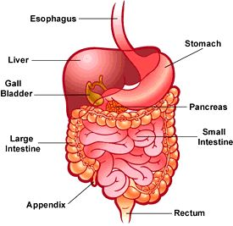
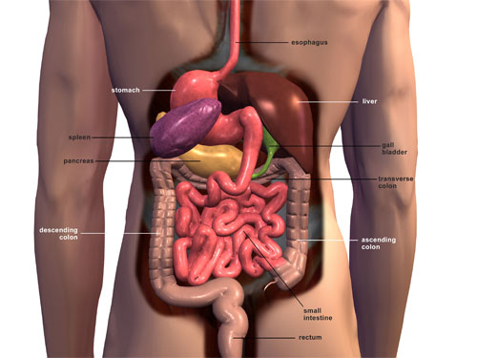
GI Tract

Slide 6
The process of Digestion: (takes place in the GASTROINTESTINAL TRACT)
G.I. =
MOUTH
ESOPHAGUS
STOMACH
SMALL INTESTINE
LARGE INTESTINE

Slide 7
Three Functions:
Digestion
Absorption
Elimination

Slide 8


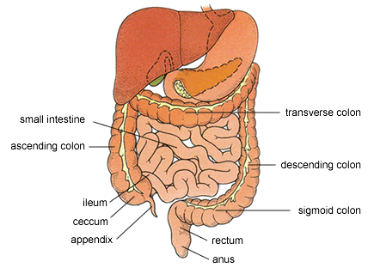
Digestion aka Metabolism
Physical and chemical breakdown of foods into smaller pieces. Eventually breaking food down into the nutrients we use for energy, body repair, etc.

Slide 9
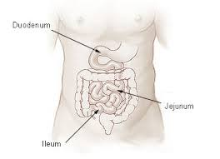
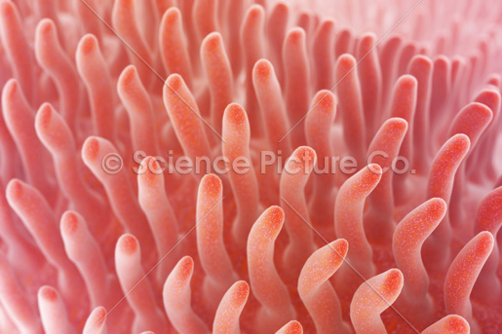
Absorption
The passage of digested food from digestive tract into the circulatory system.
Small Intestine Villi

Slide 10

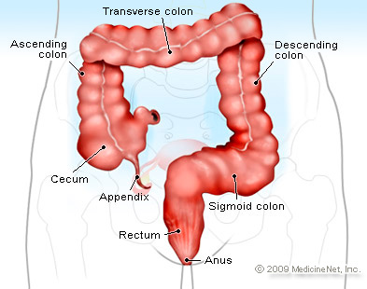
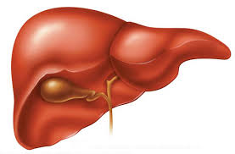
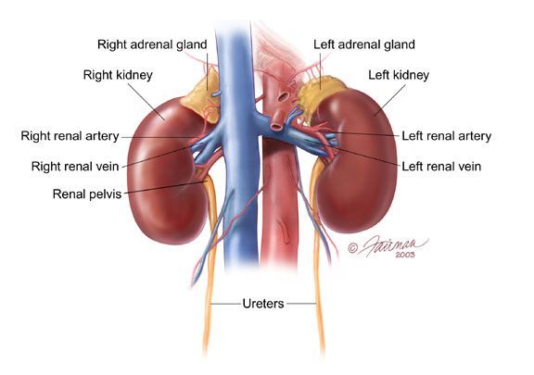
Elimination
The expulsion (removal)of undigested food or body wastes.
Colon Liver Kidneys

Slide 11
T.O.D.
Summarize in 30 words or less what you have learned about today.
Share your summary with a partner.
Add any important information that you missed.
Turn into bin.

Slide 12
October 15th, 2013
Read article.
Circle any words you don’t understand.
Summarize article in complete sentences.

Slide 13
October 29th, 2013
What are the three jobs of the digestive system?
Explain metabolism.
Why is it important for you to understand the digestive system?

Slide 14
LQ’s
Explain what digestive actions are taking place in the following structures:
  Mouth
  Esophagus
  Stomach
  Small intestine
  Colon
  Liver
  Gall Bladder
  Pancreas
  ______________ is another term for chewing.
  Bolus is …
  The term for the muscle contractions in the esophagus is _______________________.
  What job does the villi perform?

Slide 15
Mouth
The teeth and saliva tear and break food down into a more useable substance BOLUS. This process is called MASTICATION or chewing.

Slide 16
Esophagus
Muscular tube that extends from the pharynx (throat) to the stomach.
This tube is made of smooth muscle and will always push food towards the stomach even when you are on your head. This is called peristalsis.

Slide 17
Stomach
Is the preparation and holding area for bolus. Here bolus will have some digestive enzymes added to it
Then bolus will wait to be sent to the small intestine.

Slide 18
Small Intestine
Where most digestion and absorption occurs.
Digestion is the breakdown of food (using enzymes, acids, & muscular contractions) into useable nutrients.
Absorption is the taking of the nutrients and placing the nutrients in the blood stream.
Villi are finger like structures inside the Small intestine which remove Nutrients from small intestine to blood stream. Circulatory system then transports nutrients throughout the body.

Slide 19
T.O.D.
Summarize in 30 words or less what you have learned about today.
Share your summary with a partner.
Add any important information that you missed.
Turn into bin.

Slide 20
October 31st, 2013
Describe the digestive function that occurs in each structure:
  Mouth
  Esophagus
  Stomach
  Small Intestine
  What is Mastication, peristalsis, and bolus?

Slide 21
Large Intestine (Colon)
Removes semisolid waste called feces from the body using rectum and anus.

Slide 22
LQ
Explain how the following organs contribute to digestion:
  Liver
  Gall Bladder
  Pancreas
  Kidneys/Bladder
  What is a nephron?
  List and describe problems a person may have with the digestive system.
  What are the symptoms of GERD?
  How would you treat GERD?

Slide 23
Organs that help in digestion
Liver:
Produces Bile, which breaks down fats.
Converts sugar glucose to glycogen, a starch, and stores it until needed (energy from foods).
Maintains glucose levels in the blood (blood sugar).
Removes worn out red blood cells.
Changes toxic substances into a less toxic substance (alcohol).
Stores vitamins and iron (A,D,E,K).

Slide 24
Organs that help in digestion:
Gallbladder
Stores bile
Pancreas
Produces three enzymes that are released in the small intestine that digest proteins, fats, and carbohydrates. Also releases insulin and glucagon into body.

Slide 25
Kidneys
Kidneys:
Bean shaped
Size of a fist
Located in the small of the back on either side of the spine
Filters every drop of blood in your body once an hour
You can survive with only one kidney
Nephron is the functional unit of the kidneys. When blood enters the kidney the Nephron removes substances the body does not need (urine- liquid waste material) and returns what is needed back into the blood.
Bladder:
Muscular organ that stores urine
Stores about a pint (16 oz. 500 to 600ml) of urine
When bladder is full sphincter muscle relaxes and urine passes through urethra

Slide 26
Problems of the digestive system
GERD (Gastroesophageal reflux disease)
Diarrhea/Constipation
Ulcers
Hepatitis
Cancer
Celiac disease

Slide 27
October 28th, 2013
Describe the function of the Kidney’s/Bladder.
What is a nephron?
What are some problems a person may have with their digestive system?

Slide 28
October 22nd, 2013
Look at Project Grading Sheet.
Organize your portfolio into the sections that will be graded.
Put name on grading sheet.
Turn in grading sheet with portfolio..

Slide 29
GERD
Gastro Esophageal Reflux Disease
AKA- Heart burn, Gas
Symptoms/Results:
  Pain and discomfort of the chest
  Cough
  Trouble swallowing
  Asthma attacks
  Esophageal damage
  Cancer

Slide 30
How to relieve GERD
Do not smoke
Avoid foods that cause GERD
  Citrus foods
  Fried foods
  Chocolate
  Spicy foods
  Tomato based foods
  Smaller meals, more frequent meals
  Avoid laying down for about 3 hours after a meal

Slide 31
Bell Ringer 11/4/13
Try to answer the following questions by yourself, then compare answers with a peer.
What is the study of nutrition?
What are nutrients?
What functions do the individual nutrients carry out? (Fat does what?)

Slide 32
Nutrition
Nutrition- The process of learning about/analyzing food, then using knowledge for good health.
LQ’s
How do most Americans make their food choices?
How should you make food choices?

Slide 33
Nutrition
Diet-Everything you eat and drink regularly. So in actuality all people are on a diet.
LQ’s
What is the misconception (misunderstanding) that people make about a diet?
Why is the delusion about a diet harmful?

Slide 34
November 5th, 2013
What is nutrition?
What is a diet?
Why is it dangerous for a teen to “diet”?

Slide 35
Nutrition
Nutrients- Substances found in foods that our bodies need to grow, have energy, and stay healthy.
Types of nutrients:
  Carbohydrates
  Fats
  Proteins
  Minerals
  Vitamins
  Water
  Secondary Nutrients
  Fiber
  Antioxidants

Slide 36
T.O.D
Summarize in 30 words or less what you have learned about the Nutrients/Calories (write in complete sentences).
Share your summary with a partner.
Place T.O.D. in bin, make sure your name is on it.

Slide 37
Reading writing assignment
Read article.
Circle any words you do not understand.
Summarize article.
Re-read the Proposed Policy Changes.
Choose one of the changes and explain how you believe it would help change America's Negative Food Culture.
Use complete sentences and proper grammar.
Turn into bin when completed.

Slide 38
October 29th, 2013
Describe Nutrition and Diet.
What are the 6 nutrients?
What other substances are necessary to your diet?

Slide 39
Calories
A calorie is a unit of energy that a food contains. Most things we consume have calories (not water).
Calories that are not used will be stored as fat.
Balancing calories with exercise is important to achieving Wellness.

Slide 40
November 6th, 2013
Describe nutrients.
What are the 6 nutrients?
Describe calories.

Slide 41
November 7th, 2013
Describe calories.
What are empty calories?
Why is knowing you caloric intake important?

Slide 42
Calories, cont.
Empty Calories-Foods that tend to be high in calories and low in nutrients.
3500 calories = 1 pound of weight (fat/muscle).
Sedentary girls require only about 1,800 calories
Inactive boys need about 2,200
Participation in daily sports or other vigorous
activities: Girls need about 2,400 and Boys need anywhere from 3,000 to 5,000

Slide 43
Nutrients
Carbohydrates- Starches and sugars that provide the body with most of its energy. Should be 45 to 65% of Caloric intake.
Carbs give you 4 calories per gram.
Point to remember :Simple carbohydrates do not have to be a poor dietary choice, limit/ avoid High fructose Corn Syrup.

Slide 44
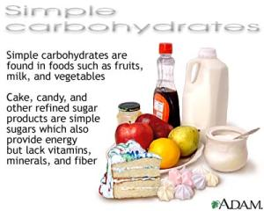
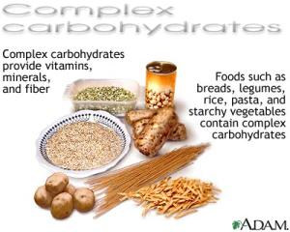
Types of carbohydrates
Simple carbohydrates- Sugar, found in fruit, milk and honey.
Complex carbohydrates- Starches found in breads, pastas, rice, potatoes, and corn.

Slide 45
T.O.D
Summarize in 30 words or less what you have learned about the Carbohydrates, Fats, Proteins(write in complete sentences).
Share your summary with a partner.
Place T.O.D. in bin, make sure your name is on it.

Slide 46
October 31, 2013
Describe calories.
Explain why all calories are different.
Describe carbohydrates.

Slide 47
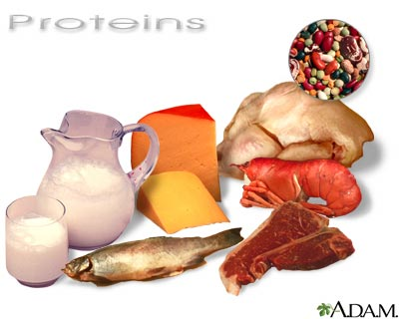
Nutrients
Proteins- essential nutrients used to repair body cells and tissues, this includes skeletal muscle. Should be 15 to 30% of Caloric intake.
4 Calories /gram of protein.

Slide 48
Types of proteins
Complete proteins- Found in milk, eggs, and fish. (animal products) These proteins contain all 9 essential amino acids.
Incomplete proteins- Found in beans and grains. (plant products)
These proteins DO NOT contain the essential amino acids. People who eat these proteins need to mix proteins so they get the essential amino acids necessary repair and building.

Slide 49
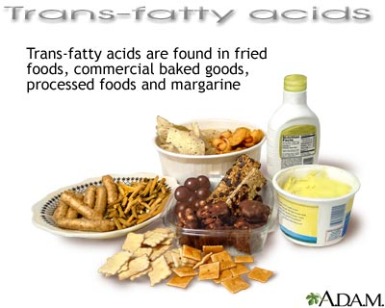
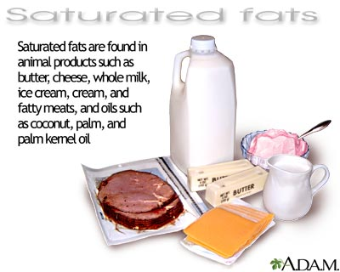
Nutrients
Fats- Source of energy, stores vitamins, and insulates the body (less than 60 to 80 grams per day). Fat should be 20 to 30% of calories.

Slide 50
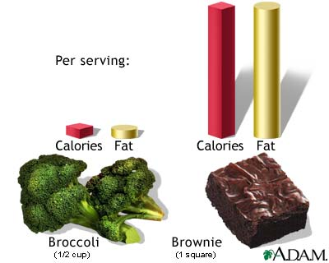
Types of fat
Saturated fat- Fats found in meats and dairy, these fats will raise Cholesterol. (less than 20 to 30 grams)
Unsaturated fat- Liquid fats that come from plants.
Trans fats occur in manufactured foods during the process of partial hydrogenation, when hydrogen gas is bubbled through vegetable oil to increase shelf life and stabilize the original polyunsaturated oil. The resulting fat is similar to saturated fat, which raises "bad" LDL cholesterol and can lead to clogged arteries and heart disease

Slide 51
November 4th, 2013
Describe
  Proteins
  Fats
  Contrast
    Complete and incomplete proteins
    Vegetarian/Vegan diet and Animal products diet
    Saturated, trans fat and Unsaturated fat

Slide 52
November 6th, 2013
Why is it important to know the calories per gram that are in fats, carbs, & proteins?
How do you know a food has trans-fat in it?

Slide 53
Pyramid-terms-1’s face screen 2’s back to screen. Start at lower left hand side
Mastication
Colon
Pancreas
Stomach
Incomplete Protein
Trans Fat
Diet
ComplexCarbs
Nutrients
Bolus
Start

Slide 54
Pyramid-terms-1’s face screen 2’s back to screen. Start at lower left hand side
Liver
Saturated Fat
Peristalsis
Saliva
Antioxidants
Incomplete Proteins
Nutrition
Simple carbohydrate
Unsaturated Fat
Esophagus
Start

Slide 55
LQ’s #3
Describe vitamins.
The two types of vitamins are ___________ & _____________________.
Contrast water and fat soluble vitamins.
Describe minerals.
What are some functions of water?
How much water should you consume per day?
Describe fiber.
Why are fibrous foods important to your diet?
Can you consume too much fiber?
Describe antioxidants.
Explain why too much sugar in a diet is a problem.
Explain why too much salt in a diet is a problem.

Slide 56
Vitamins
Organic materials that are essential to maintaining life functions.
  Water soluble-
    Vitamin B (Metabolism of food to energy)
    C (Helps HDL levels, antioxidants, immunity, and joints), dissolve in water, must be replaced daily.
  Fat soluble-
    A (skin, mucous membrane linings)
    D(Sunshine vitamin; stores calcium), E(Immunity/antioxidants),
    K(Clots blood) dissolve in fat, will be stored until needed.

Slide 57
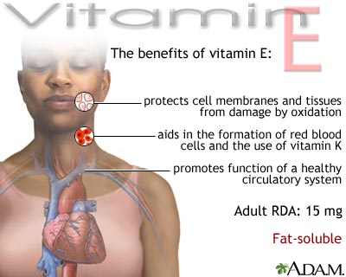
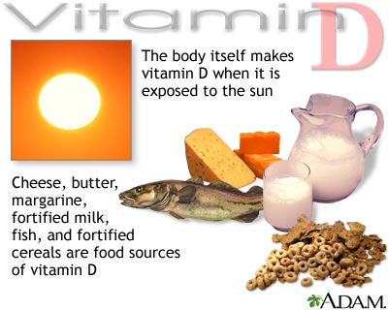
Vitamins
Water soluble- Vitamin B and C, dissolve in water, must be replaced daily. Vitamin B (Metabolism) and C (Helps HDL levels, antioxidants, immunity, and joints),
Fat soluble- A, D, E, K dissolve in fat, will be stored until needed. A (skin, mucous membrane linings) D(Sunshine vitamin; stores calcium), E(Immunity/antioxidants), K(Clots blood)

Slide 58
Nutrients
Minerals- Substances that also help life functions. Life functions like strengthen muscles, bones, and teeth; enrich the blood; and keep other organs working
Examples: Calcium and Fluoride are good for bones and teeth. Iron strengthens red blood cells. Potassium, sodium, and chloride regulate water balance in body tissues.

Slide 59
Nutrients
Water- The most essential nutrient.
Water breaks down food, carries nutrients, removes waste, and regulates body temperature.
You should drink 64 oz of water daily.
Strenuous activity as adult half body weight in ounces, if above 64 oz.

Slide 60
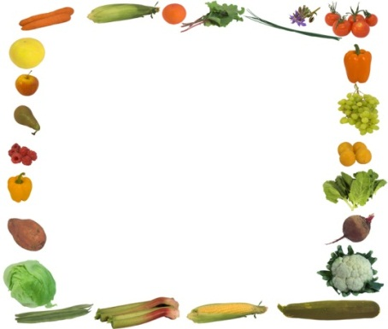

Other substances in your diet
Fiber- the part of grains, fruits, and vegetables that the body can not breakdown. Fiber helps digestion, elimination of wastes, and fighting cancer.

Slide 61
Antioxidants
Substances or nutrients that remove free radicals from your body. Free radicals are substances that can cause aging, cancer, illness, among other issues.
Antioxidants (vitamins and other substances)are found in fruits, vegetables, beans (Soy), tea/coffee, flaxseed, among others.

Slide 62
What to watch for in your diet:
Too much sugar can cause tooth decay, excess fat storage, and type II diabetes.
Too much sodium (Salt) can cause water retention (excess weight), raise heart rate. (less than 2400 mg/day)

Slide 63
T.O.D
Summarize in 30 words or less what you have learned about the protein/fat (write in complete sentences).
Share your summary with a partner.
Place T.O.D. in bin, make sure your name is on it.

Slide 64
11/12/13
Read article
Circle any words you don’t know.
Summarize article.

